Slide 1
Apps Project
Emeka Nwosu

Slide 2
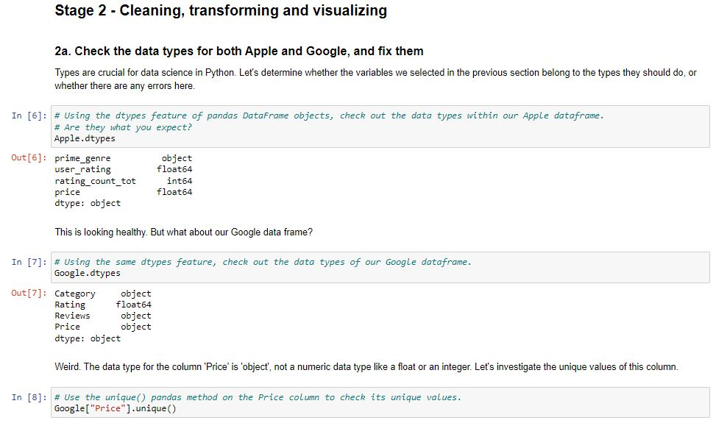
Stages 1 & 2: Sourcing & Cleaning Data
Data came in 2 CSV Files (Apple and Google)
Necessary columns: Category, Rating, Reviews, Price
Converted price strings to numeric (removed “$”)
Appended the two datasets rowise

Slide 3
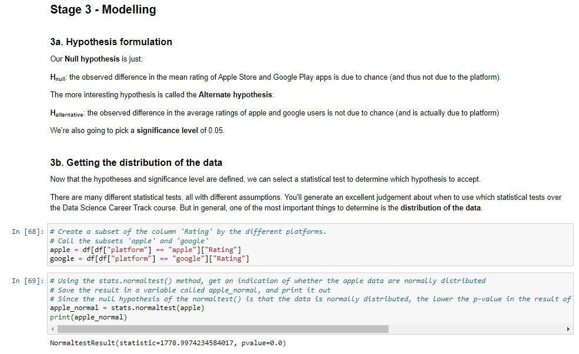
Modeling
Hnull: the observed difference in the mean rating of Apple Store and Google Play apps is due to chance (and thus not due to the platform)
Halternative: the observed difference in the average ratings of apple and google users is not due to chance (and is actually due to platform)

Slide 4
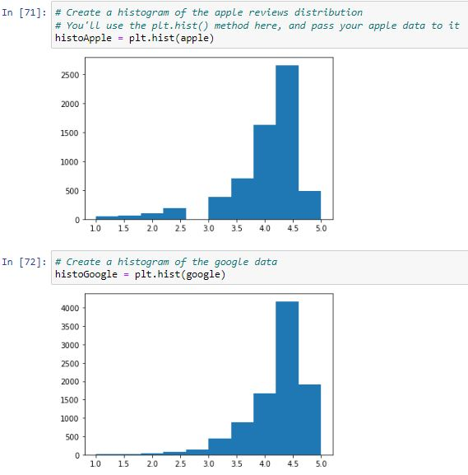
Visualization
First double plot is the histogram of reviews from each platform
Second single plot is the histogram of the difference in scores

Slide 5
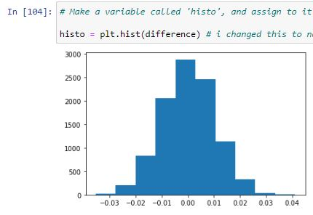
Conclusion
When sampled 10,000 times, the difference in means between the two groups is normally distributed around 0

